Slide 1

Spread the Love
Pay it forward

Slide 2
Instructions: Paying it Forward
Paying of Forward means passing along kindness to others! It is usually contagious, so the person who received the kindness may pay it forward to someone else.
Select three items from the list on the next slide and circle them. Sign the contract!
Throughout the day and evening, please complete all three items. You will pay it forward and make someone’s day brighter.
Who knows? Maybe the person we receives your kind act will pay it forward to anther person. Think about how you feel as you complete there three acts of kindness

Slide 3
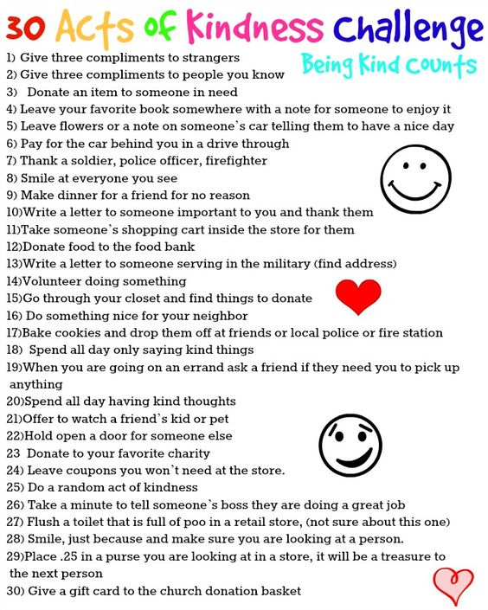

Slide 4
Student Contract
I, _____________________________ (sign your name), promise to complete all three pay it forward activities by tonight.

Slide 5
Assignment D
Using a google document write about ONE of the pay it forward experiences you complete yesterday. Explain what you did and how it made you feel. Try to explain how the person reacted. Use good sensory details to describe what you did! Try to include some figurative language such as similes or hyperbole. Also include dialogue between characters (quotes) if you can. This is a journal style entry be creative with good details. Include pictures if you wish.

Slide 6
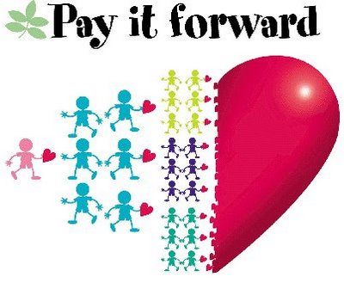
Extension
Hobbs Municiapal Schools challenges you to pay it forward next week and the week after! See if you can make it part of your life routine!
This Photo by Unknown Author is licensed under CC BY-NC-ND

